Slide 1
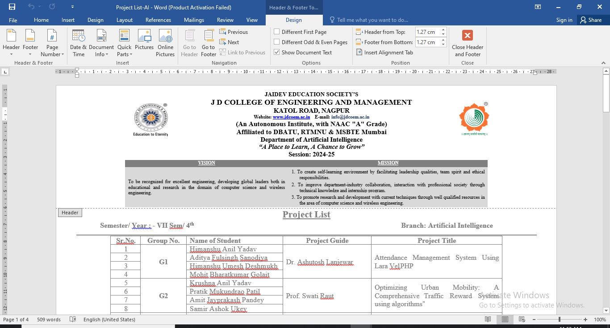
Progress Seminar No.- 1
Title: A mobile app for women’s safety provides real-time
SOS alerts and location sharing for emergency
response.
Under the Guidance of Dr. Ashutosh Lanjewar
Designation: Assistant Professor, JDCOEM, Nagpur
Presented by :
1)Himanshu Deshmukh 3) Himanshu Yadav
2)Aditya Sanodiya 4) Mohit Golair
January-2025

Slide 2


INDEX (for Final Year)
Introduction
Problem definition
Literature Review
Aim and Objectives
Proposed work: Basic Idea/ Methodology
Tools
Techniques
Experimental set up /Design/ Mathematical model/Algorithms
Probable work implications
Publication if any
Book Chapter if any
Patents/Copyright if any
References

Slide 3
Introduction
The protection of women is a pressing global concern, as incidents of harassment, domestic abuse,
sexual assault, and other forms of violence continue to rise worldwide. In many regions, women
often face challenges in accessing immediate help due to societal barriers, delayed law enforcement
response, or insufficient legal protections. Consequently, there is a growing need for innovative,
accessible, and responsive safety mechanisms that empower women to seek help at critical
moments. This study presents the development of a mobile-based Women Safety Application
(WSA), designed to provide women with a quick, discreet, and effective means of alerting their
trusted contacts during emergencies.
The WSA leverages smartphone technology to overcome common challenges that individuals may
face in moments of danger. At its core, the app uses a vigorous shake gesture to trigger an
emergency alert, ensuring that the user can activate the application without the need to unlock their
phone or navigate complicated menus. This functionality is particularly valuable in high-risk
situations, where every second counts, and the ability to act discreetly can mean the difference
between safety and harm. Once the shake gesture is detected, the app immediately sends a pre
configured emergency message, along with the user’s real-time GPS location, to selected
emergency contacts.

Slide 4
Literature Review
Sr. No. | Paper Title | Author | Publication & Year | Key Points
1 | bSafe a panic button and location sharing for women safety | Fazli Subhan. Alina Mirza | MDPI, open access scientific journals Artificial Intelligence and Robotics in Healthcare 2023 | This paper explain trending the IoT applications and medical wearables utilized in the modern era for the detection and prevention of multiple diseases are discussed and compared.
2 | AI Driven women safety solutions | Rajeswari ChengodenNancy Victor, Thien Huynh | IEEE 2023 | This paper presents an exhaustive survey of the applications of the Metaverse in healthcare. Firstly, the current digital healthcare scenario and the need for implementing the Metaverse for healthcare are briefed.
3 | AI IOT SOS Alert system for women safety | Joel J. P. C. Rodrigues | Journal of Sensors 2022. | The aim of this paper is to bring together IoT applications and medical wearables utilization and discussing how to improve digital healthcare using a sensor-based environment.

Slide 5
Research Gap
Integration of data from multiple sensors: While the proposed device integrates data from accelerometers, gyroscopes, cameras, and other sensing interfaces, there is a need to explore how to efficiently integrate the data from multiple sensors in real-time, considering the potential noise and interference.
Development of intelligent algorithms: Although the device captures and stores data from multiple sensors, there is a need to develop intelligent algorithms that can analyze and process the data to extract meaningful information for surgeons and other healthcare professionals.
Human factors and user interface design: The device is designed to be used during surgeries, and there is a need to understand the human factors and ergonomic requirements for designing a user interface that is easy to use and does not cause any distractions for the surgeon.

Slide 6
Statement of the problem
Women's safety remains a critical concern across the globe, with increasing reports of harassment,
assault, and other forms of violence. Despite advancements in law enforcement and emergency
services, there remains a significant gap in ensuring real-time help during emergencies. Women
often face situations where immediate action is required, but the lack of accessible and efficient
tools delays assistance, leaving them vulnerable. Traditional safety measures, such as helpline
numbers and manual calls to emergency contacts, are not always practical during panic situations
or physical altercations, where reaching for a phone and navigating through multiple screens may
not be feasible.
In this context, there is an urgent need for a technology-driven solution that provides quick access
to emergency assistance with minimal user input. An ideal solution would allow users to trigger
alerts through simple gestures and automatically communicate their location and distress status to
trusted contacts and authorities. With the widespread use of smartphones, there is an opportunity
to leverage mobile sensors, GPS, and messaging platforms to design a safety application that
enables faster response times and enhances personal security.

Slide 7
Objectives of the study
• Develop a Gesture-Based Emergency Activation System: Implement an accelerometer
based shake detection mechanism that triggers emergency alerts. This feature allows users
to activate the alert by shaking their device, making it quick and accessible, especially in
high-stress situations.
• Incorporate Real-Time Location Sharing: Utilize GPS technology to capture the user’s
location at the moment of distress. The system will share the exact latitude and longitude
with emergency contacts, enabling them to track the user and provide assistance promptly.
• Enable WhatsApp Integration for Emergency Messaging: Automate the process of
sending SOS alerts via WhatsApp, including pre-configured messages with the user’s real
time location. This ensures that emergency contacts receive instant notifications, facilitating
rapid action.
1/9/2025

Slide 8
Scope
Real-time monitoring & feedback during surgery: An AI-powered IoT interface can monitor real-time data from sensors & other devices during surgery & provide instant feedback to surgical staff. This can help detect potential risks or errors, provide real-time guidance, & ensure a safer and more accurate surgical procedure.
Surgical planning & preparation: The system can assist in surgical planning & preparation by analysing patient data and providing insights that can help optimize surgical procedures. This can include identifying the most effective surgical techniques and predicting potential complications before surgery.
1/9/2025

Slide 9
IMPLEMENTATION
• Frontend:
o Built with HTML, CSS, and JavaScript to provide a simple, user-friendly
interface.
o Users can easily add, edit, and remove emergency contacts, configure shake
sensitivity, and customize alert messages.
• Backend:
o Native mobile APIs are used to monitor the phone’s accelerometer for detecting
high-intensity shakes.
o GPS services provide real-time location to track the user.
o WhatsApp API integration allows the app to send automated messages containing
the user’s location and alert details to emergency contacts.

Slide 10
Methodology
1. Requirement Analysis
2. System Design
3. Technology Stack Selection
4. Development Process
5. Testing and Validation
6. Deployment
7. Future Enhancements

Slide 11
Tools
2. Design Tools
• Figma/Adobe XD: Used for UI/UX design and prototyping. These tools allow designers to create wireframes and interactive prototypes, facilitating user testing and feedback before implementation.
• Canva: Useful for creating graphics and promotional materials related to the application.
3. Development Tools
• Frontend Development:
o HTML/CSS/JavaScript: Core technologies used for building the user interface of the application. HTML structures the content, CSS styles it, and JavaScript adds interactivity.
o React Native/Flutter: Frameworks that enable the development of cross-platform mobile applications, allowing code sharing between iOS and Android.
• Backend Development:
o Node.js: A JavaScript runtime used for building the backend services of the application, handling requests, and processing data.
o Express.js: A web framework for Node.js that simplifies the development of APIs and server-side logic.
o Firebase: A platform that provides cloud-based services such as real-time database, authentication, and hosting, which can be leveraged for backend functionalities.

Slide 12
Techniques
1. Shake Detection using Accelerometer
• Accelerometer-based Gesture Recognition: The application utilizes the phone’s accelerometer to detect high-intensity shake gestures as a trigger for initiating the emergency alert system. This ensures that users can quickly activate the safety mechanism without navigating through the app. Threshold-based Activation: A predefined intensity threshold helps in distinguishing accidental shakes from intentional ones, minimizing false alarms.
2. WhatsApp API Integration
• Automated Messaging System: The application uses WhatsApp API to send predefined emergency messages directly to the user’s emergency contacts. The message includes:
o User’s name
o Real-time location (latitude and longitude)
o Distress alert notification
• Reason for Choosing WhatsApp: The widespread use of WhatsApp ensures that messages are instantly delivered, and the contacts can respond without the need for additional apps.

Slide 13
Work Plan
Developing an efficient AI-powered IoT interface for assisting clinical surgeries is a complex and multi-disciplinary project that involves various stages, including problem identification, requirements gathering, design, development and testing, implementation and deployment, and monitoring and evaluation. The following work plan outlines the high-level tasks and timeline for each stage of the project:
Problem identification: 20/07/2023
Requirements gathering: 25/09/2023
Design: 20/07/2023
Development and testing: 20/07/2023
Implementation and deployment: 20/07/2023
Monitoring and evaluation: Ongoing
1/9/2025

Slide 14
Implications
Technology Stack
• Frontend:
o Built with HTML, CSS, and JavaScript to provide a simple, user-friendly
interface.
o Users can easily add, edit, and remove emergency contacts, configure shake
sensitivity, and customize alert messages.
• Backend:
o Native mobile APIs are used to monitor the phone’s accelerometer for detecting
high-intensity shakes.
o GPS services provide real-time location to track the user.
o WhatsApp API integration allows the app to send automated messages containing
the user’s location and alert details to emergency contacts.

Slide 15
Conclusions (expected)
The Women Safety Application (WSA) provides a reliable, fast, and user-friendly way for women
to seek immediate help during emergency situations. The use of mobile sensors ensures that the
app can be triggered intuitively through a simple gesture, eliminating the need to unlock the phone
or navigate through multiple screens. This feature is particularly beneficial in high-stress situations
where every second matters.
The integration with WhatsApp’s messaging platform further enhances the app’s effectiveness by
enabling seamless communication with emergency contacts. The use of WhatsApp ensures that
messages containing real-time location data are promptly delivered, even in areas with poor internet
connectivity, as it can function over cellular networks. The combination of automatic alerts and
GPS tracking allows responders to locate the user quickly and provide timely assistance.

Slide 16
References
S. Barad, "Mobile Applications for Women’s Safety in India: A Review," International Journal of Information Technology, vol. 9, no. 2, 2020.
A. Gupta and P. Sharma, "Smart Solutions for Women’s Safety: An Emerging Need," Journal of Mobile Technology, vol. 5, no. 4, 2019.
R. Kumar, "Real-Time Location Sharing and Emergency Response System for Women Safety," in IEEE Conference on Mobile Applications, 2021
J. Patel and M. Singh, "Women’s Safety: A Comparative Study of Mobile Applications," International Journal of Security and Privacy, vol. 7, no. 3, 2020
S. Verma and P. Reddy, "IoT-Based Safety Systems for Women," Journal of Mobile Computing, vol. 8, no. 5, 2019.

Slide 17
Thank You!!!
1/9/2025

